Slide 1
Project
30-Day Apple Stock Price Forecast
Forecasting Apple stock prices for the next 30 days
Comparative analysis of ML & statistical models
Insights for financial decision-making
Built using ARIMA, SARIMA, Random Forest & XGBoost

Slide 2
Mentor & Team Members
Mentor: Prajwal AN
Team Members:
1. Durga Prasad
2.Kumaraswamy T G
3. Harshith
4. Srivalli
5. Niveda
6. Prashanth

Slide 3
Objective
The main objective is to forecast Apple's stock price for the next 30 days by analyzing historical data (2012–2019) and comparing multiple models.
This helps investors and traders make informed decisions.

Slide 4
Problem Statement
Stock markets are highly volatile. Predicting future prices accurately can help in investment planning.
This project builds, compares, and evaluates models to find the most accurate predictor.

Slide 5
Dataset Details
Dataset Source: Yahoo Finance
Years: 2012 to 2019
Columns: Date, Open, High, Low, Close, Adj Close, Volume
Target Variable: Close Price
Initial checks: No missing values, data sorted by date.

Slide 6
EDA – Closing Price Trend
The closing price shows an overall upward trend with noticeable dips due to market corrections.
This helps understand long-term movement and volatility.

Slide 7
EDA – Moving Averages
30-day and 90-day moving averages smooth out short-term noise.
They help identify trend direction, momentum, and potential support/resistance zones.

Slide 8
EDA – Volume Analysis
Trading volume spikes indicate major market events, earnings announcements, or external global events.
High volume confirms strong market movement.

Slide 9
EDA Summary
• Stock grows steadily over years
• Occasional fluctuations due to events
• No missing values after cleaning
• Trend + seasonal + random behavior present

Slide 10
Models Used
Four models used:
1.Persistent model – Final saved model
ARIMA – Linear trend capture
2. SARIMA – Seasonality + trend
3. Random Forest – Non-linear patterns
4. XGBoost – Complex pattern boosting
Each model was evaluated for accuracy.

Slide 11
ARIMA Model Explanation
ARIMA captures trend and autocorrelation.
Good for baseline prediction but weak with seasonality.
Used as the simplest statistical model.

Slide 12
SARIMA Model Explanation
SARIMA enhances ARIMA by adding seasonality.
Ideal when data repeats yearly/monthly.
Better accuracy than ARIMA for Apple stock.

Slide 13
Persistent Model Explanation
Persistent Model saves the trained final model for reuse.
Allows instant predictions without retraining.
Improves app performance and deployment efficiency.

Slide 14
Random Forest Explanation
Random Forest uses lag features (1–7 days), moving averages, and other engineered features.
Good for non-linear relationships.

Slide 15
XGBoost Explanation
XGBoost boosts performance using gradient boosting.
Handles non-linear patterns effectively.
Most accurate model in this project.

Slide 16
Feature Engineering
Features created:
• Lag values (1–7 days)
• Rolling averages
• Date-based features
Train-test split: 80% training, 20% testing.

Slide 17
Evaluation Metrics
Metrics used:
• RMSE – Measures prediction error
• MAE – Measures average absolute error
• R² Score – Measures model fit
XGBoost achieved the best scores.

Slide 18
Model Comparison
Pesistent > XGBoost > Random Forest > SARIMA > ARIMA
XGBoost handled market fluctuations best.
Random Forest also performed strongly.

Slide 19
Final 30-Day Forecast
The final forecast shows stable short-term trend continuation.
Persistent produced the most reliable predictions.

Slide 20
Insights & Key Findings
• Apple stock shows consistent upward growth.
• Short-term predictions highly reliable.
• Persistent is is the best model.
• Forecast useful for traders & analysts.

Slide 21
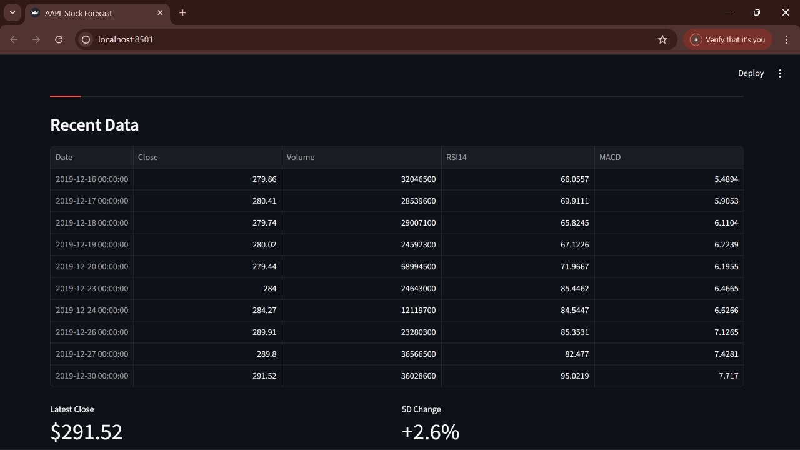
Streamlit App Screenshot
Streamlit app displays line charts, forecast outputs, and prediction tools.
Easy-to-use interface for quick forecasting.

Slide 22
Challenges Faced
• Date format issues in dataset
• Sudden spikes affecting models
• Hyperparameter tuning
• Non-stationary data
Resolved with preprocessing and feature engineering.

Slide 23
Solutions Implemented
• Cleaned and standardized dates
• Applied differencing
• Added lag features
• Tuned parameters for best model accuracy

Slide 24
Conclusion
Successfully built and compared 5 ML models.
30-day forecast generated.
XGBoost proved most accurate.
App ready for real-time forecasting.

Slide 25
Thank You

